Slide 1
Skillenza Data Science Challenge
Forecasting Sales for champagne
Presented by
Vaibhav Agrawal

Slide 2
Problem Description
The problem is to predict the number of monthly sales of champagne for the Perrin Freres label (named for a region in France)
The dataset provides the number of monthly sales of champagne from January 1964 to September 1972, or just under 10 years of data.
The values are a count of millions of sales and there are 105 observations.
Dataset link:
https://datamarket.com/data/set/22r5/perrin-freres-monthly-champagne-sales-millions-64-72#!ds=22r5&display=line

Slide 3
Environment
Python Version
Python 3.5.2
Libraries used
scipy: 0.19.1
numpy: 1.13.1
matplotlib: 2.0.2
pandas: 0.20.1
sklearn: 0.18.2
statsmodels: 0.8.0

Slide 4
Test Harness
Test harness to investigate the data and evaluate candidate models involves two steps:
Defining a Model and Validation Dataset
last one of year of history will be used for model validation and rest of the data for model development
Developing a Method for Model Evaluation.
Performance Measure.
Test Strategy.

Slide 5
Defining a Model and Validation Dataset
Model Dataset
Model dataset will be used to develop and test model.
Validation dataset
Validation dataset will be used to finally validate the model after development
The specific contents of these files are:
dataset.csv: Observations from January 1964 to September 1971 (93 observations)
validation.csv: Observations from October 1971 to September 1972 (12 observations)

Slide 6
Model Evaluation
Performance Measure
Forecasting model can be evaluated based on MAD, MAPE, RMSE etc
Root mean squared error (RMSE)- will be used for evaluating models in present case study
Test Strategy
The first 50% of the dataset will be held back to train the model.
The remaining 50% of the dataset will be iterated and test the model.
For each step in the test dataset:
A model will be trained.
A one-step prediction made and the prediction stored for later evaluation.
The actual observation from the test dataset will be added to the training dataset for the next iteration.
The predictions made during the iteration of the test dataset will be evaluated and an RMSE score reported.

Slide 7
Baseline Model
In our baseline model we will assume that our forecast will be equal to our last period sales.
We use observation from the previous time period as the prediction for the next time period
We will execute the test harness using this baseline model and use baseline RMSE for comparing other models.
RMSE for the baseline model is 3186

Slide 8
Data Analysis
Summary Statistics.
Line Plot.
Seasonal Line Plots
Box and Whisker Plot.

Slide 9
Summary Statistics
count 93.000000
mean 4641.118280
std 2486.403841
min 1573.000000
25% 3036.000000
50% 4016.000000
75% 5048.000000
max 13916.000000
The number of observations (count) matches our expectation, meaning we are handling the data correctly.
The mean is about 4,641, which we might consider our level in this series.
The standard deviation relatively large at 2,486 sales suggest a large spread to the data

Slide 10
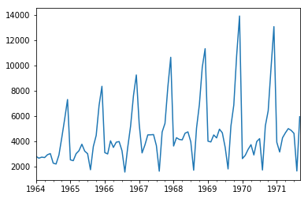
Line Plot
Following observations are made from above plot:
There is increasing trend in sales from 1964 to 1971
Sales pattern is showing a seasonal sales pattern over 12 month period.

Slide 11
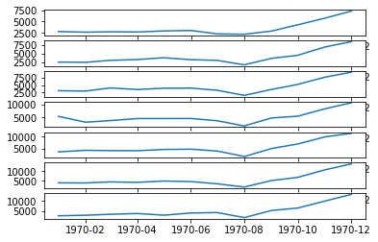
Line plot by year
Line plot is plotted side by side for easy comparison. It clearly shows similar seasonal pattern over the years

Slide 12
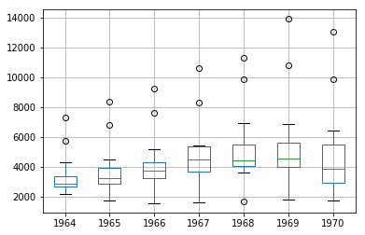
Box Whisker Plot
Box whisker plot clearly shows increasing mean sales for each year
Outliers correspond to the peak seasonal sales during the year.

Slide 13
Model Development
Several Models can be used for forecasting time series. Some of the candidates are:
Simple Exponential Smoothing
Double Exponential Smoothing
Triple Exponential Smoothing
Crostons Method
ARIMA models
Since our given data series shows trend and seasonality. Our choice of model reduces to Triple exponential smoothing or ARIMA model
We will use ARIMA model for current case study

Slide 14
Assumptions
Typically Retailers run promotions throughout the year and also have stakeouts. History data need to be cleansed for following effects before applying any forecasting algorithm.
Lost Sales Correction
Outlier Correction
Promotion Correction
In the absence of any details on promotions or inventory data, we cannot cleanse present time series for these effects. So we will assume there are no promotions and lost sales in given data.

Slide 15
ARIMA Models
The ARIMA(p,d,q) model requires three parameters and is traditionally configured manually.
Analysis of the time series data assumes that we are working with a stationary time series.
The time series is almost certainly non-stationary. We can make it stationary this by first differencing the series and using a statistical test to confirm that the result is stationary.
The seasonality in the series is seemingly year-to-year. Seasonal data can be differenced by subtracting the observation from the same time in the previous cycle, in this case the same month in the previous year.
Created a deseasonalized version of the series and saved it as file stationary.csv

Slide 16
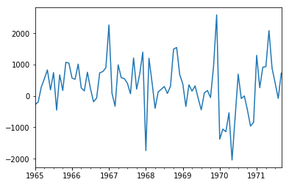
Plot of Differenced Series
Above differenced series is obtained by subtracting the observation from the same time in the previous cycle, in this case the same month in the previous year.
Series looks stationary with no obvious trend or seasonal pattern, we will confirm using statistical test

Slide 17
Test for Stationarity
We will use augmented Dickey-Fuller to test the hypothesis that the series is stationary
Following are test statistics on stationary data series
ADF Statistic: -7.134898
p-value: 0.000000
Critical Values:
1%: -3.515
10%: -2.586
5%: -2.898
ADF test statistic (-7.134898) is less than our critical value (-3.515) for 1% significance level. Hence we reject the null hypothesis at 1% significance level and conclude that series is stationary without any time dependence.

Slide 18
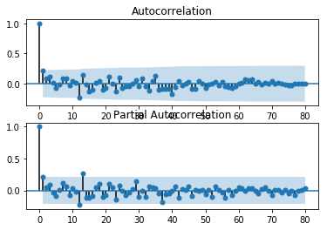
Selecting ARIMA parameters
Since we have converted the time series to stationary manually, we need not difference series again in the model. So d =0
Lets review ACF and PACF plots for choosing values of p and q
ACF shows a significant lag for 1 month.
The PACF shows a significant lag for 1 month
Possible choice of parameters is p=1 , q=1 and d=0
ARIMA Model : ARIMA(1,0,1)

Slide 19
ARIMA Model fitting
Training the ARIMA model as per Test Harness strategy:
Trained ARIMA(1,0,1) model on the Train data (50% of data)
Model is tested against the Test data (remaining 50% data)
Underlying ARIMA library gives error that series is not stationary when ARIMA(1,0,1) model is used. So the model can be extended to ARIMA(1,1,1)
We will also disable the automatic addition of a trend constant from the model by setting the ‘trend‘ argument to ‘nc‘ for no constant in the call to fit()
RMSE with ARIMA(1,1,1) model on Test dataset = 956

Slide 20
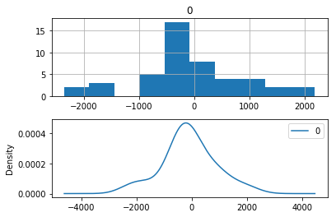
Reviewing Residual Errors
Residuals are almost centered around zero, we can assume model is not having any bias.

Slide 21
Model Evaluation
Our Baseline Model RMSE was 3186
RMSE from ARIMA(1,1,1) model is 956 which is significantly lower than base model.
We can also try different parameters of ARIMA at this stage and compare RMSE for these models.
Finalize this model and save the model for future predictions

Slide 22
Rolling Forecast and Model Validation
Retest the model again with the validation dataset that we saved earlier to confirm the validity of our model
Load the saved model and compute the rolling forecast for the next 12 months(October 1971 to September 1972)
Compare the observations with the forecast and compute RMSE
Computed RMSE: 340.922 which is aligned with the RMSE we computed in Test data

Slide 23
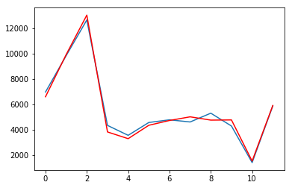
Forecast and Observations on Validation dataset

